Slide 1
Company Introduction
All ABOUT SOUND & VIBRATION

Slide 2
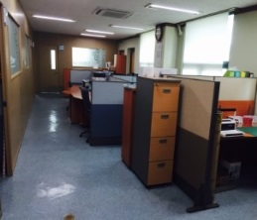
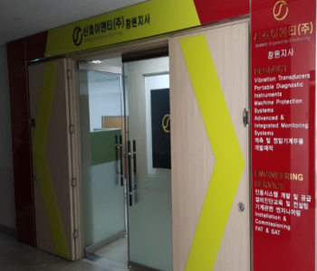
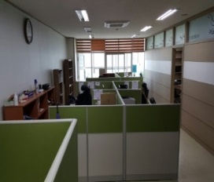
Company Introduction
Shinho E&T
Vibration Education & Technical Support
Junction Box & Instruments Cooperation
Diagnosis & Analysis Consulting
Technical Cooperation
Expert Advisory
The Industrial-Academic Cooperation Foundation
Ulsan Headquarters
Changwon Branch
Founded : August, 2004
Location : Room 306, 8, Hwahap-ro
102beon-gil, Nam-gu,
Ulsan, Korea
STAFF : 4
Business : VIBRATION/INSTRUMENT
Founded : February, 2015
Location : Room 407, 50, Wanam-ro,
Seongsan-Gu, Changwon-si,
Gyeongsangnam-do, Korea
STAFF : 4
Business : VIBRATION/INSTRUMENT
Homepage : www.shinhoent.co.kr
E-mail : info@shinhoent.co.kr

Slide 3
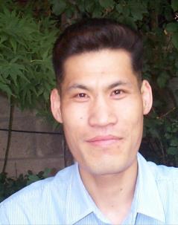
CEO Introduction
■ CEO
Degree
1. | A bachelor’s degree in Mechanical Engineering at Pukyong Nat’l University
2. | A Master of Engineering in Acoustic Vibration at Pukyong Nat’l University
3. | A Ph. D Candidate in Acoustic Vibration at Pukyong Nat’l University
With more than 20 years in the field, we are getting expertise by acquiring knowledge and experience. Many ups and downs help us create our value.
We take our pride in offering our quality service and the best selection in vibration system.
We are doing our best for our customers and pursuing our better future.
- CEO LEE So Hwan
Period | Careers (Post)
1997.03~2000.02 | T.A in Mechanical Engineering (T.A)
2000.02~2004.06 | NADA S&V Co., Ltd. (Director)
2000.02~2004.06 | Small & Medium Business Corporation Training Center (Instructor) - Vibration Education
2004.08 | Korea Industrial Technology Association Training Center (Senior Professor) - Vibration Education
 | Korea Hydro & Nuclear Power Co., Ltd. Training Center (Instructor) - Vibration Education
 | K-Water Corporation Training Center ( Instructor) - Vibration Education
 | Human Resources Development Service of Korea Industrial engineer Commission (Supervisor) - Vibration Education
2004. 09 ~ present | Shinho E&T Co., Ltd (CEO)

Slide 4
Organization Chart
CEO
Technical advise
Research & Development
Technical Sales & Support Team
Managing Support
Vibration Research
Products Sales
Consulting
Instrument Research
Products Sales
Consulting
Products
Research &
Development
Service Support

Slide 5
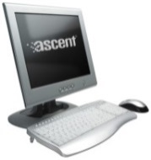
Business
■ Vibration Systems
진동 및 소음 측정 장비 렌탈
Vibration Transducer & Transmitter
Vibration Analyzer
Portable Diagnostic Instrument
Vibration and Noise Measurement system
Machine Protection System
Advanced & Integrated Monitoring System
Installation & Commissioning
FAT & SAT
Online Monitoring System
Global Network
Field of business
High Speed Balancing(HHI)
Vibration and Lubricating Service
Engineering for Machine
Facilities management System
Diagnosis and Education Consulting
Precise measurement and Diagnosis
Vibration system design
Maintenance
Diagnosis and Education

Slide 6
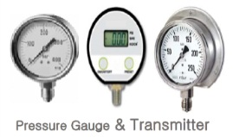
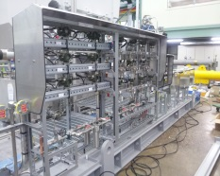
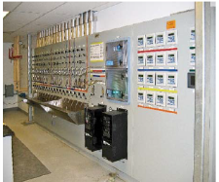
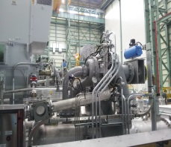
Business
■ Instrument Systems
Pressure Gauge
Temperature Gauge
Pressure Sensor
Temperature Sensor
General instrument Sale
PT & PS Panel
Gauge Board
Electric Panel
Electric Panel & Instruments
Measuring & Control component
Instrument Panel
Control Panel
Electric Control Panel
Global Network
Control System
Product Supply
Installation Construction
Installation

Slide 7
Achievements
Vibration Performance Outcome-Diagnostic Expertise
Year | Project | Company name
2005.07.~11.(5 Month) | Equipment of pump station and Structure Vibration reduction research | The korea water resources development corporation
2006. 09.14~15 | Angeko Noise of Equipmnet and Vibration diagnosis | SOLVAY Onsan plant
2007. 1.19~25 | Equipment diagnosis of A-GB101 Air-Turbo Compressor | Samsung Fine chemicals Co.,Ltd
2007.4.8~5.8 | Rotordynamics Analysis for 5,000kW LP Compressor | Samsung Fine chemicals Co.,Ltd
2007. 8.7.~9 | #2 cogeneration Steam Turbine equipment | Samsung Fine chemicals Co.,Ltd
2007.12.15.~16 | R1301-B Agitator vibration diagnosis and report | KP Chemical
2008. 8 | Reed Frequency calculation of pedestal-type sump pump | Wilo pump
2008.3.13 | Blower vibration diagnosis | poscon
2008.4.3 | SO2 BLOWER vibration diagnosis | LS-Nikko
2008. 8. | Pedestal-type sump pump Reed Frequency calculation | Wilo pump
2009. 3 | pump Reed Frequency service | Chungwoo Hydro
2010. 10 | pump noise and vibration diagnosis | Wilo pump
2010. 10.1 | Dryer Internal Gear Box vibration diagnosis | Hankuk paper Mfg.co., Ltd
2013. 7.29 | Recycle Blower vibration diagnosis | Psoco
2013. 9.25 | Cold water making installation noise and vibration Diagnosis | Namji air-conditioning.co.,Ltd
2013. 11.11 | A heat exchanger vibration Diagnosis | Solvay
2014.08.04 | Air Compressor Fault Vibration Diagnosis | TONGSUH Petrochemical Co., LTD
2014.12.29 | Vertical Pump Facility Diagnosis | Dangjin Combined Cycle Power Plant
2015.03.23 | Turbo Blower Facility Diagnosis | Kolonindustries

Slide 8
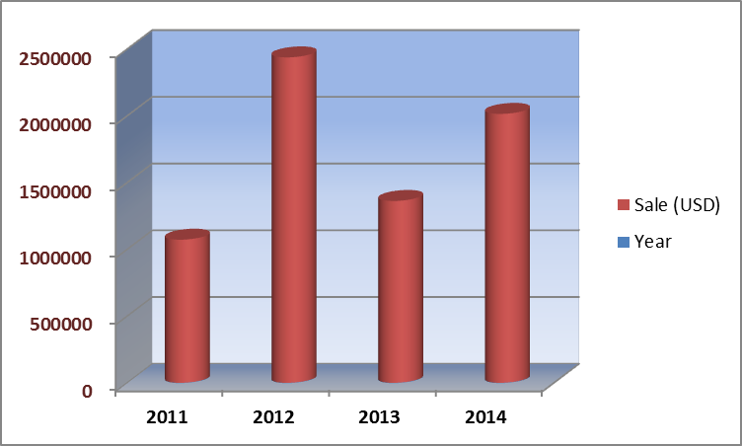
SALES REPORT
■ GROSS SALE
Year | Sale (USD)
2011 | 1,072,203.96
2012 | 2,437,853.70
2013 | 1,362,306.37
2014 | 2,014,629.95

Slide 9
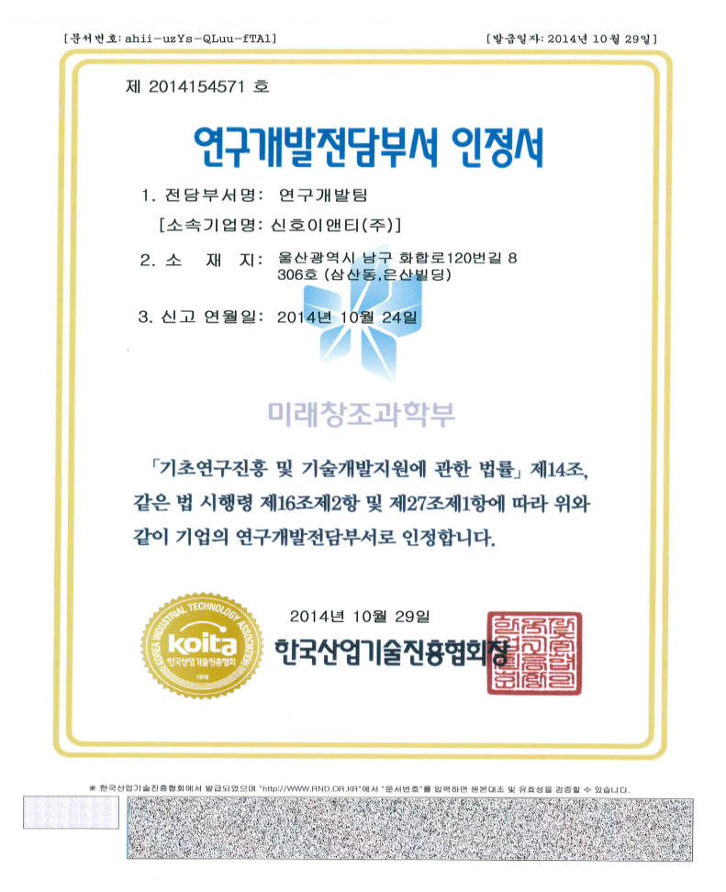
Certificate
■ Research & Development
Number : 2014154571
Certificate for its dedicated
R&D department
Dedicated R&D Department : R&D Team
(Company :SHINHO E&T Co., LTD)
Location : Room 306, 8, Hwahap-ro 102beon-gil, Nam-gu, Ulsan, Korea
Registration Date : 2014.10.24
2014. 10. 29
Korea Industrial Technology Association

Slide 10
Partner

Slide 11
Customers

Slide 12
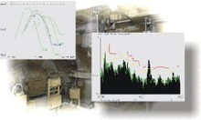
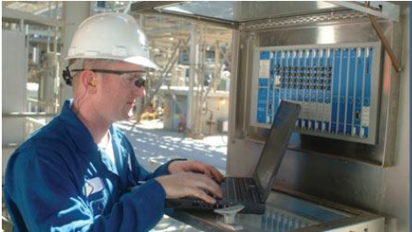
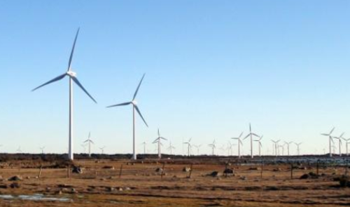
“The best of partner for You”
All ABOUT SOUND & VIBRATION
Thank You

